Slide 1
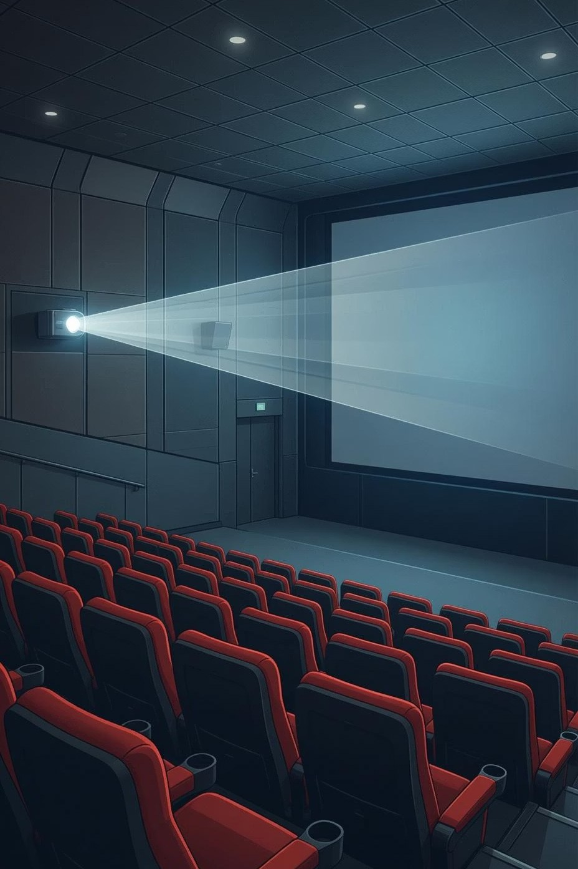
🎬🍿
Movie Ticket Booking System
A comprehensive web-based cinema booking application built with Django and Django REST Framework
Presented by:
Rutuja Sathe | Sandesh Gend | Sushant Bhosale | Ankit Kumar
Guided by:
Mrs. Yogita Wankhede
Slide 1

Slide 2
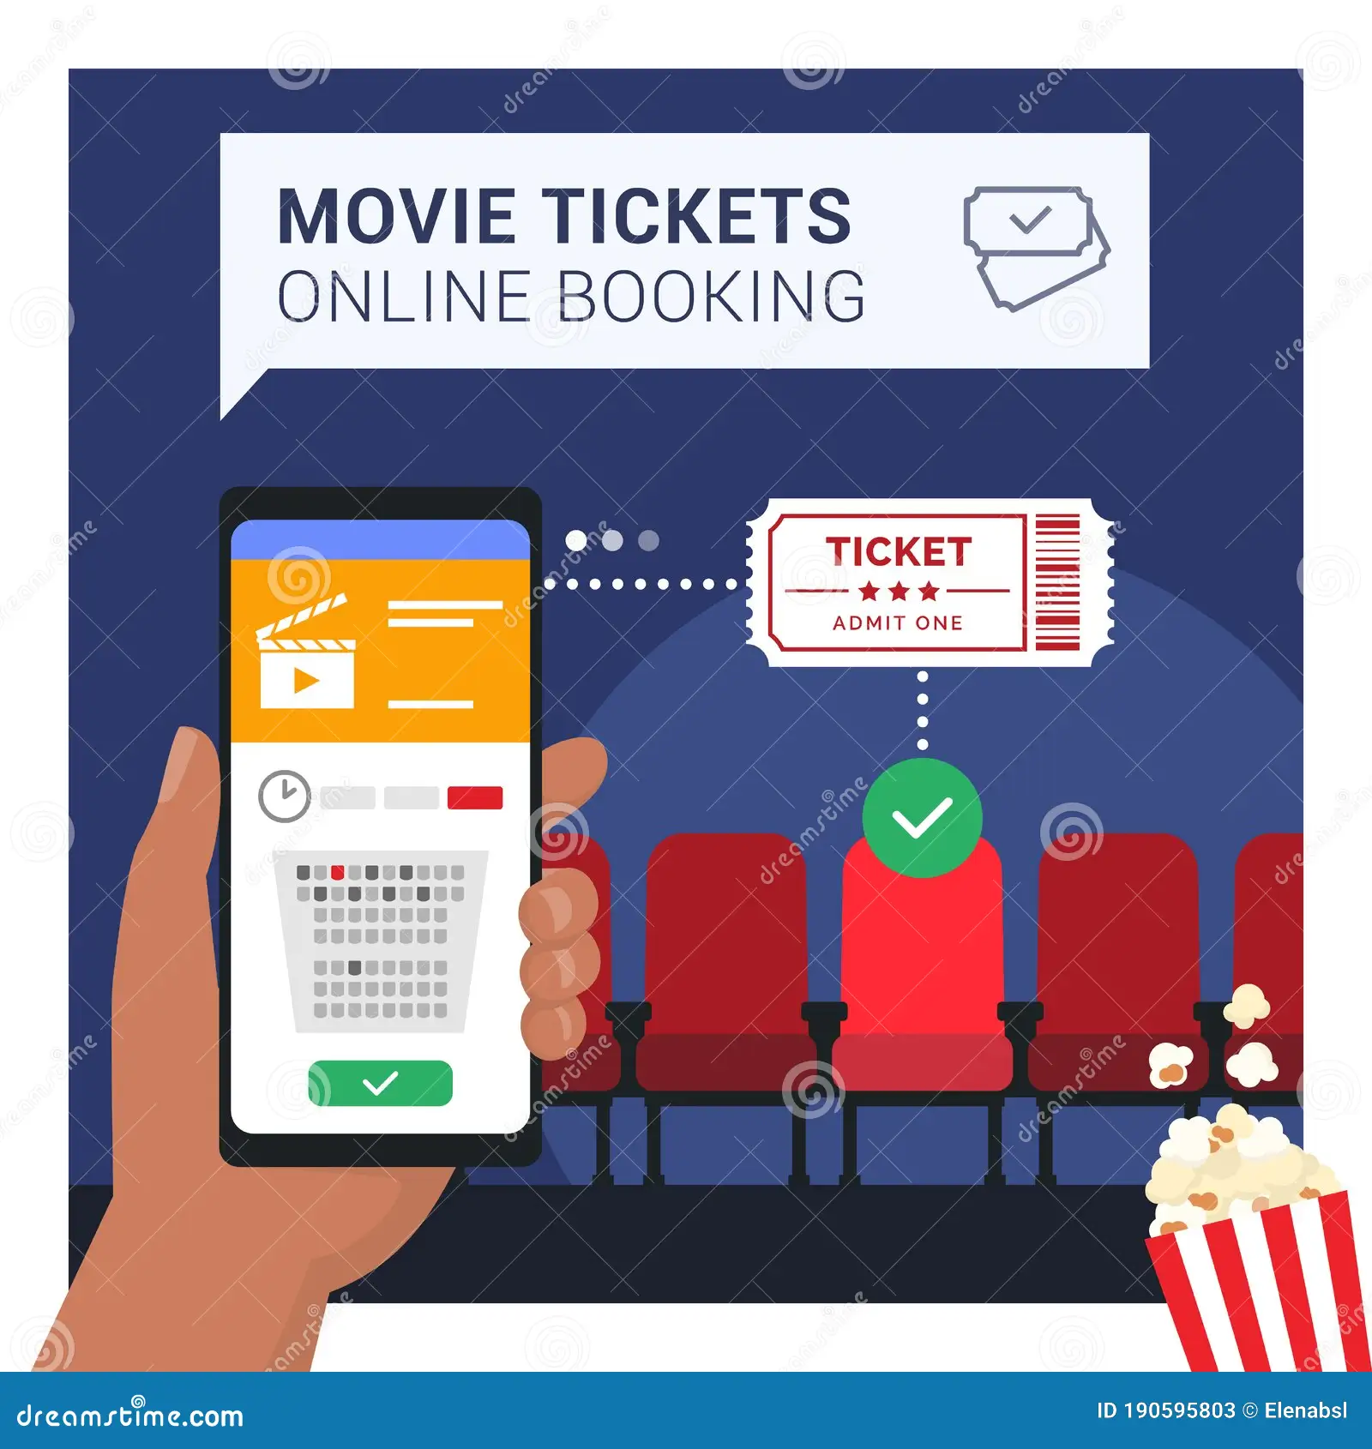
Abstract
🎯 The Movie Ticket Booking System is designed to digitalize the movie ticket booking process.
Provides a single platform for managing movies, theatres, bookings, and food orders
Reduces manual work and improves booking efficiency
Ensures a smooth and user-friendly experience for all users
Uses Django framework for security and scalability
Slide 2

Slide 3
Introduction
📱 Online ticket booking systems are widely used in today's digital world
🎫 This project allows users to book movie tickets easily through a website
🍕 Users can select seats, order food, and make payments online
⚡ Django framework provides security, scalability, and fast development
Complete Experience : Users enjoy end-to-end services: seat selection, food ordering, and secure online payments in one place
Slide 3

Slide 4

⚠️ Current Challenges:
Problem Statement
❌ Manual ticket booking leads to long queues at theatres
❌ Customers cannot easily check real-time seat availability
❌ Food ordering inside theatres is time-consuming and inefficient
❌ Managing bookings manually increases errors and operational overhead
Slide 4

Slide 5

Objectives of the Project
Online Booking Platform : Create a comprehensive web-based system that makes movie ticket booking accessible to everyone
Integrated Services :To allow seat selection and food ordering in one integrated system
Efficient Management : To manage movies, theatres, and bookings efficiently
Operational Excellence : To reduce human effort and improve accuracy in booking management
Slide 5

Slide 6
Scope of the Project
🔐 User Management
Complete registration, authentication, and profile management system with secure credentials and personalized user experiences
🎬 Ticket Booking
Full-featured online booking system including movie selection, seat reservation, food ordering, and payment processing
⚙️ Admin Management
Comprehensive administrative tools for managing movies, theatres, show schedules, and food inventory efficiently
📱 Future Expansion
System can be extended to mobile applications
Slide 6

Slide 7
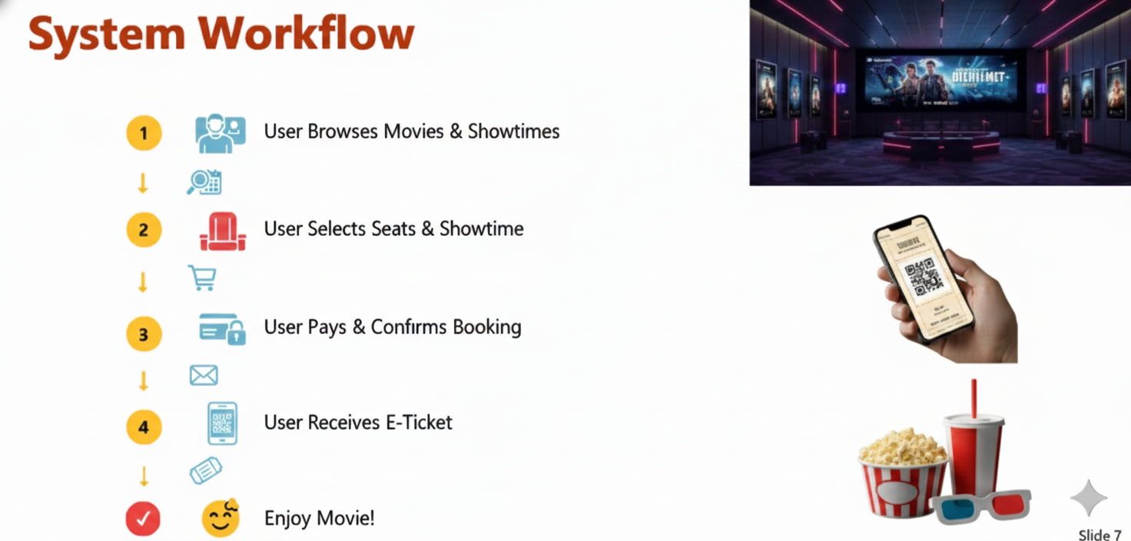
System Workflow
1
User registers or logs in
↓
2
Selects movie, theatre, show time, and seats
↓
3
Selects food items (optional)
↓
4
Completes payment securely
↓
✓
Booking and order confirmation generated
Slide 7

Slide 8
Project Modules
👤 Users Module
🎬 Movies Module
Authentication and profile management
Movie listing and details
🏢 Theatres Module
🎫 Bookings Module
Theatre locations, Seat layouts & screens Show scheduling
Ticket booking and history
🍿 Food Module
💳 Payments Module
Food menu, orders, and billing
Secure online payment processing, Multiple Payment options
Slide 8

Slide 9
Technologies & Frameworks
🐍
Backend
🔌
API
Python, Django : robust server-side framework providing ORM,authentication & admin interface
Django REST Framework : for seamless frontend-backend communication
🎨
Frontend
🗄️
Database
HTML, CSS, JavaScript creates responsive, interactive user interfaces.
SQLite Database : lightweight,reliable database for storing all application data efficiently
⚙️
Tools
📚
Additional
VS Code, Django built-in Admin panel
Django ORM, Postman API Testing tools for quality assurance
Slide 9

Slide 10

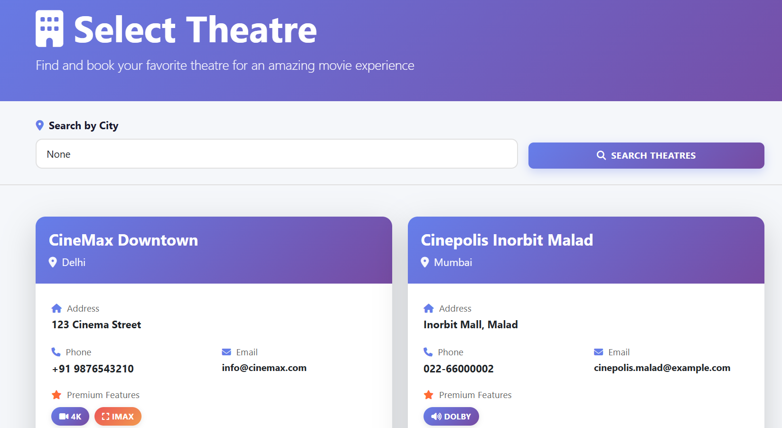
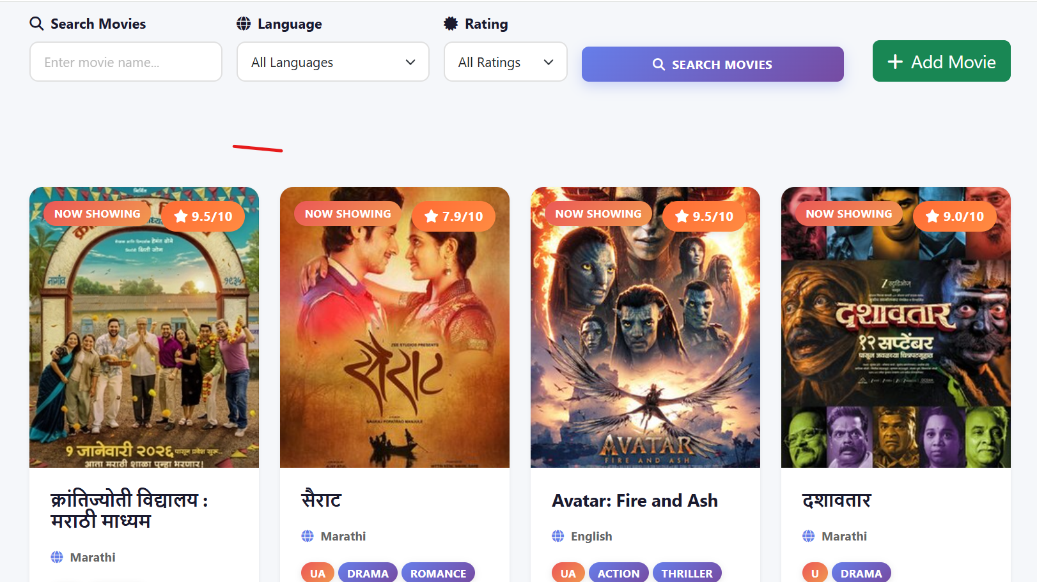
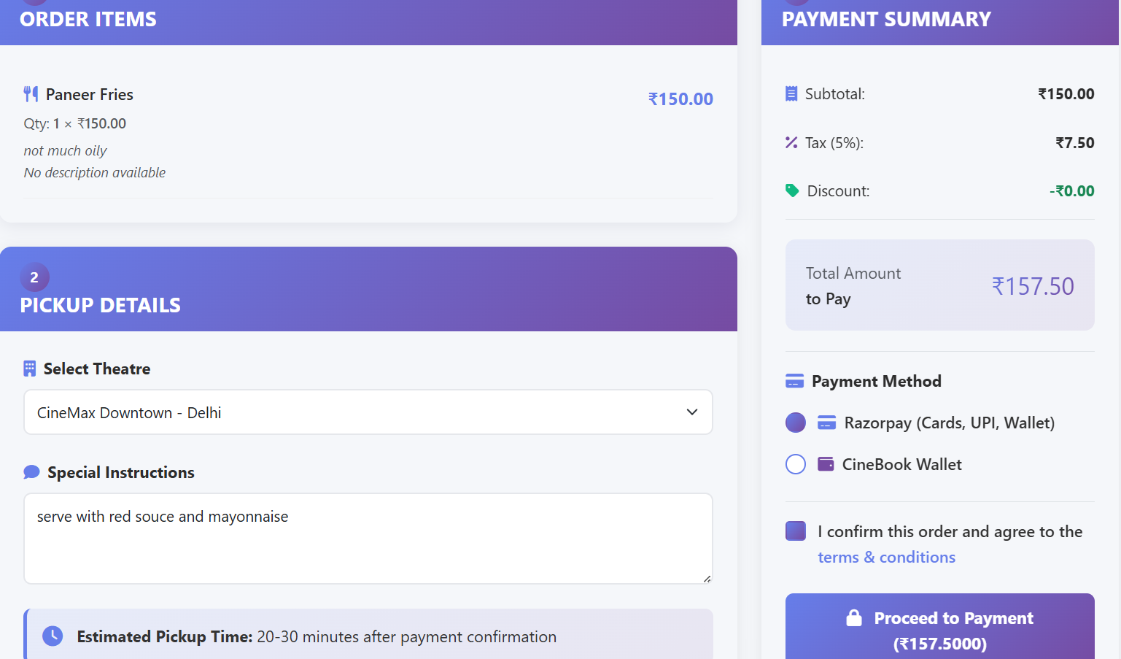
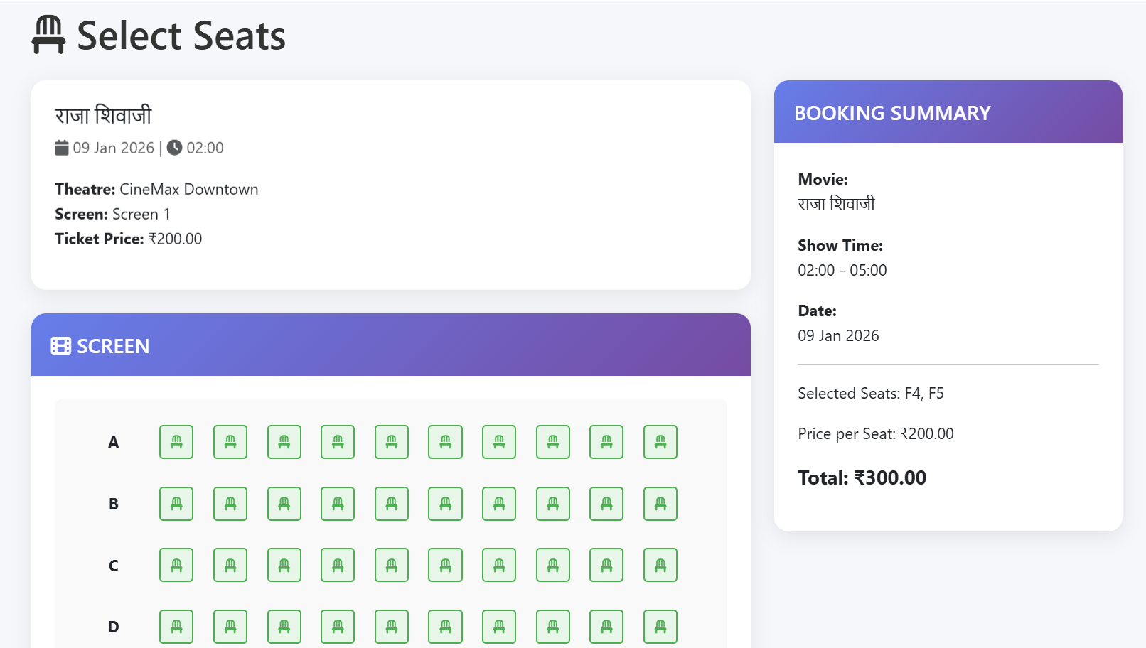

Slide 11
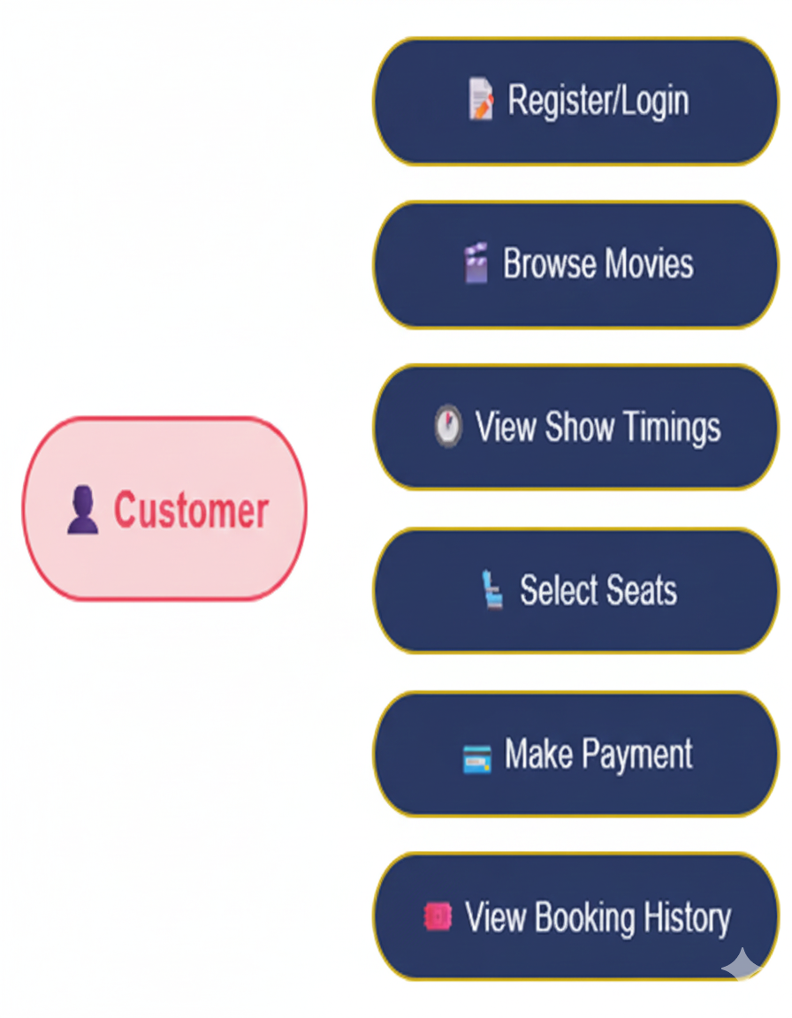
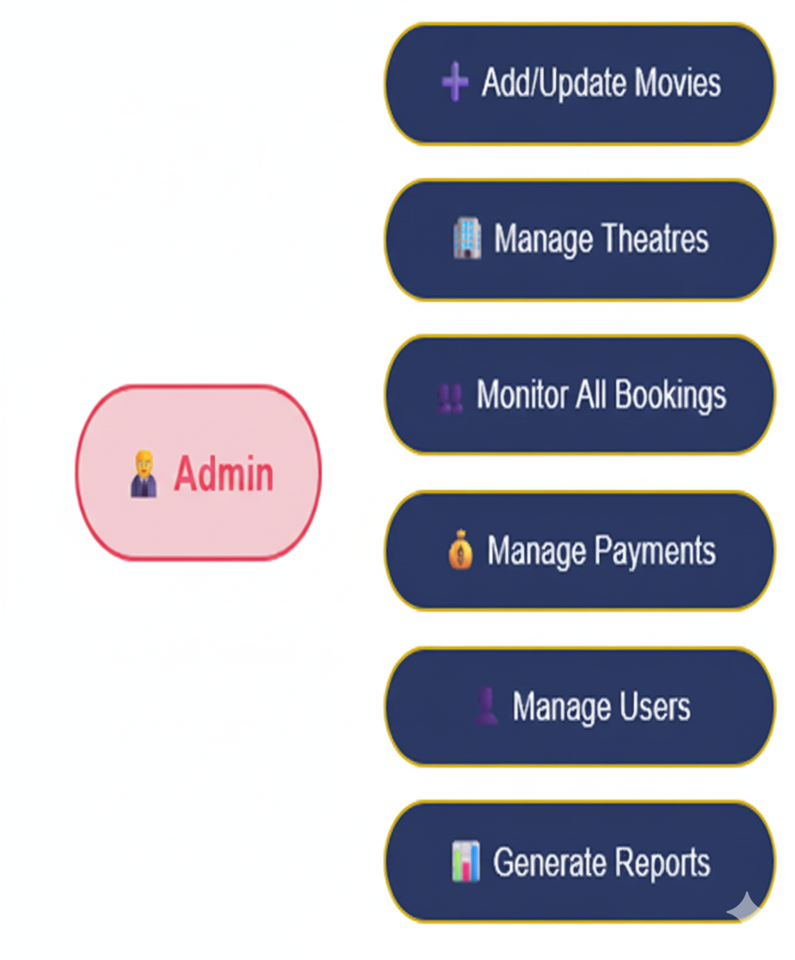
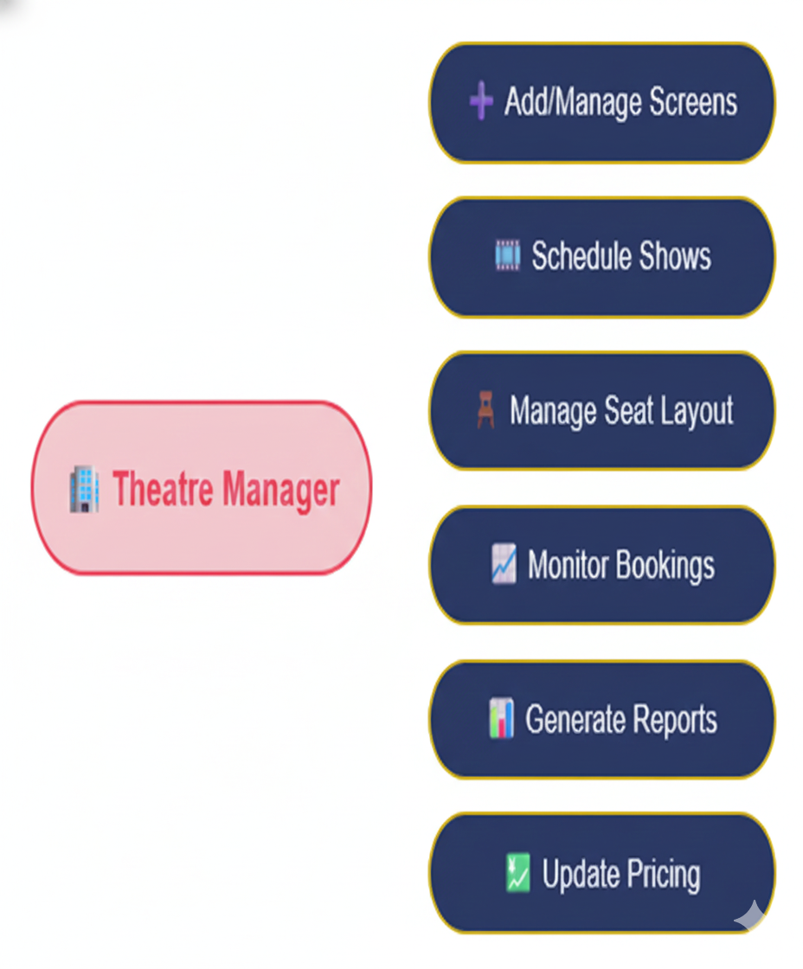
Use Case Diagrams
●
Users
●
Admins
●
Theatre Managers
Slide 10

Slide 12
Applications of the System
🌐 Online Movie Ticket Booking Websites - Users can book movie tickets anytime without standing in queues.
🏪 Multiplex Theatre Management Systems - Manage movies, shows, screens, seats, and pricing easily.
Secure Digital Payments – Online payments using Razorpay (UPI, cards, net banking).
🎭 Entertainment Platforms - Multi-venue booking ecosystem
📱 Future Mobile Booking Applications - Native iOS/Android apps via APIs
Slide 11

Slide 13
Advantages of the System
⏱️ Saves time and avoids long queues at theatre counters
🎫 Easy seat selection with visual seat layout display
🍿 Integrated food ordering - order snacks while booking
🔒 Secure payment process with safe transactions
👥 User-friendly interface for seamless experience
⚡ Efficient system with reduced manual errors
Slide 12

Slide 14
Conclusion & Future Scope
📋 Conclusion
Complete solution for online movie ticket booking
It simplifies the ticket booking process for customers while streamlining operations for theatre staff.
The system ensures accuracy, security, and convenience, reducing manual work and improving overall performance.
🚀 Future Scope
🤖 AI-based movie recommendations
💬 Chatbot for booking assistance and customer support
📱 Mobile app development using REST APIs
💳 Multiple payment gateway integration
Slide 13

Slide 15

* THANK YOU *

